Slide 1


Conserving evolutionary processes
Jeffrey Hanson
jeffrey.hanson@uqconnect.edu.au
jeffrey-hanson.com

Slide 2
Acknowledgements

Slide 3
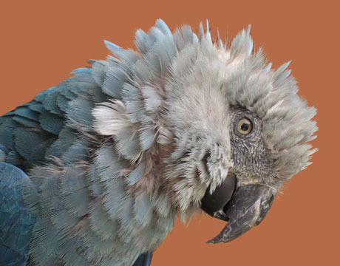
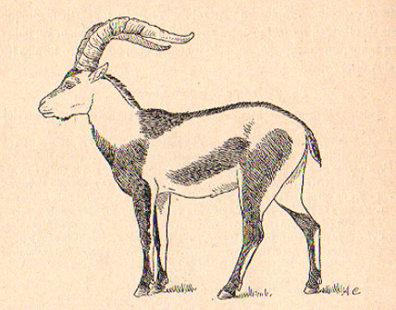
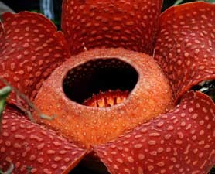
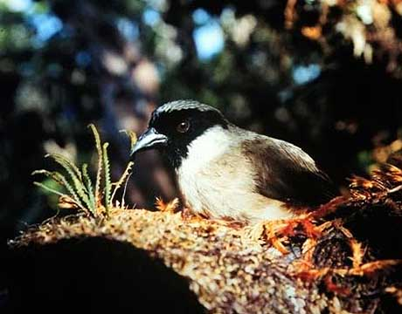
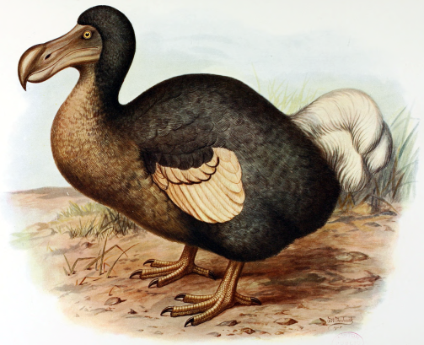
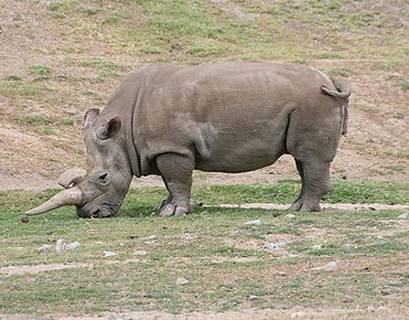
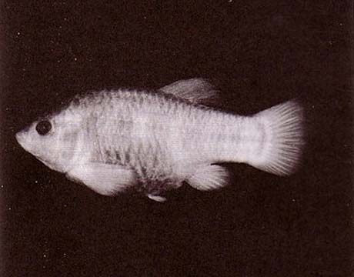
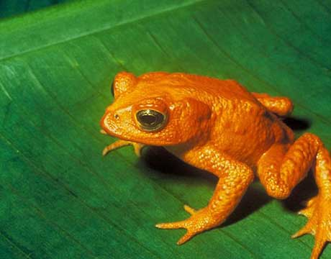
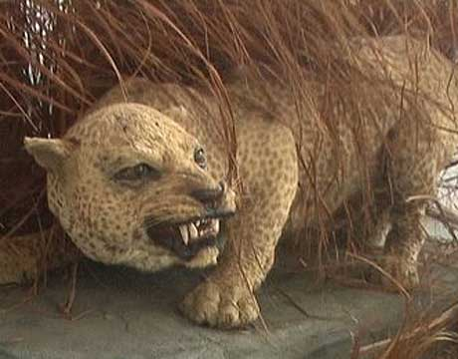
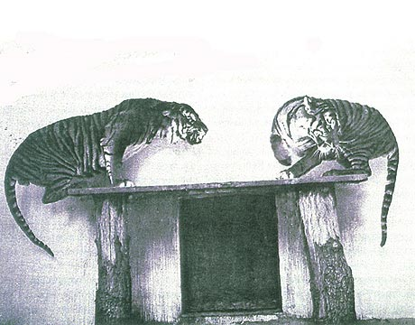
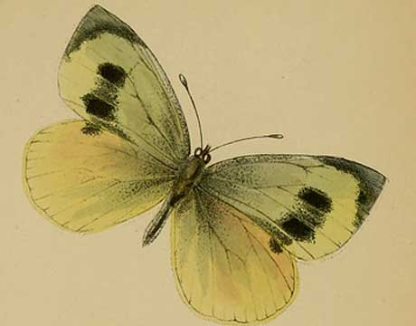
Global biodiversity crisis
Notes:
- high extinction rate
- conservation aims to maintain existing patterns of biodiversity and the processes that sustain them
- areas set aside to preserve biodiversity, and spearhead direct management actions
Include dodo & plant

Slide 4
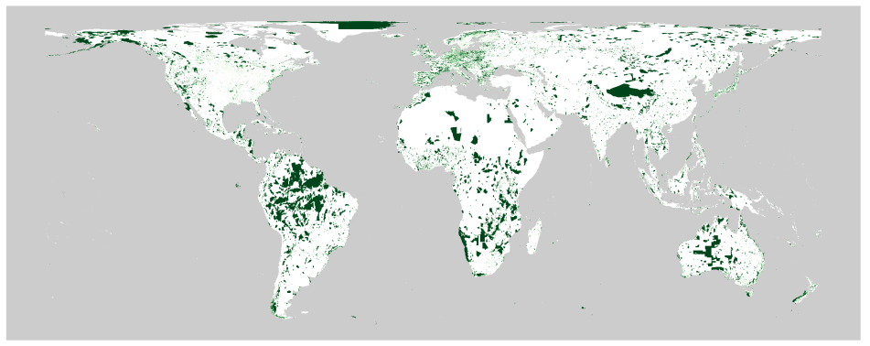

Protected areas
100%
75%
50%
25%
0%

Slide 5
Reserve Selection
Notes:
- not all remaining habitat can be preserved
- achieve conservation objectives for minimal cost
- modern systematic conservation planning primarily focusses on representing species
- however, this ignores intra-specific biodiversity

Slide 6
Reserve Selection

Slide 7
Reserve Selection

Slide 8
Reserve Selection

Slide 9
Evolutionary processes
Adaptation

Slide 10
Evolutionary processes
Neutral

Slide 11
Evolutionary processes
Gene flow

Slide 12

raptr: representative and adequate prioritization toolkit in r
Create a general reserve selection method to identify adequate and representative networks
Compare solutions generated to conventional reserve selection methods

Slide 13
Sampling a continuous space
A
B
C
Temperature (°C)
D
Rainfall (mm)

Slide 14
Sampling a continuous space
A
Amount target = 75 %
B
C
Temperature (°C)
D
Space sampled = POOR
Rainfall (mm)

Slide 15
Sampling a continuous space
A
Amount target = 75 %
B
C
Temperature (°C)
D
Space target = 80 %
Rainfall (mm)

Slide 16
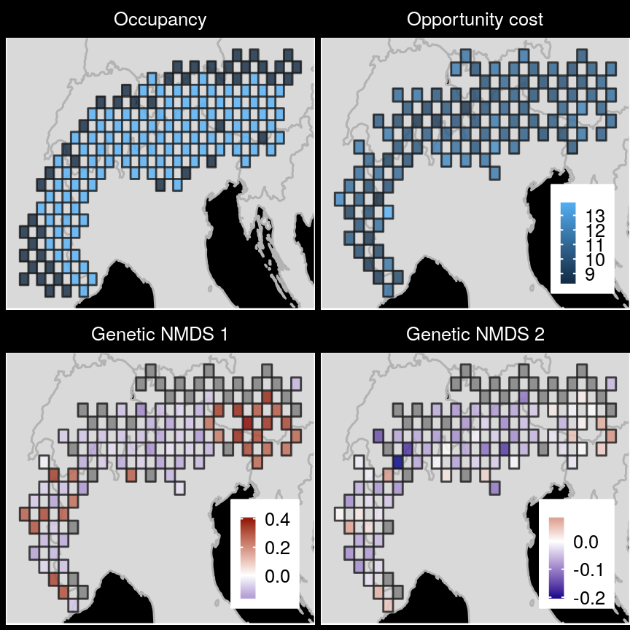
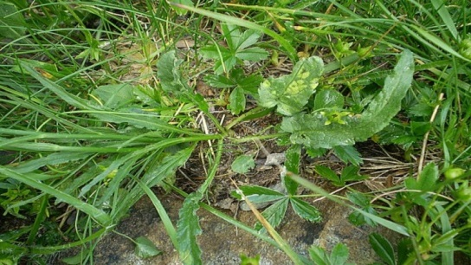
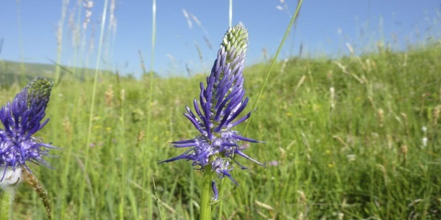
Case study
betony leaved rampion

Slide 17
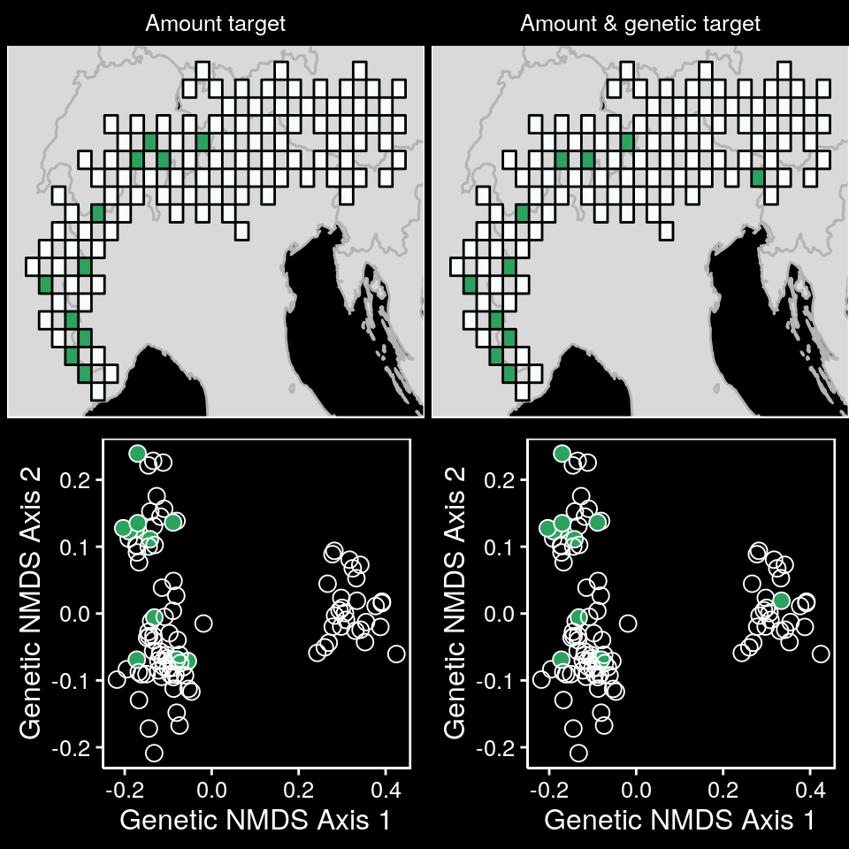
Case study

Slide 18
Case study

Slide 19
Case study

Slide 20
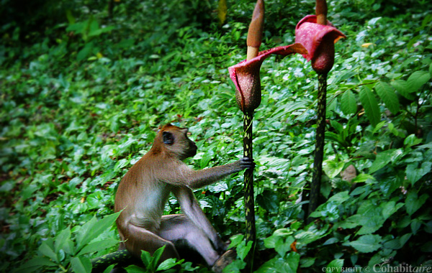

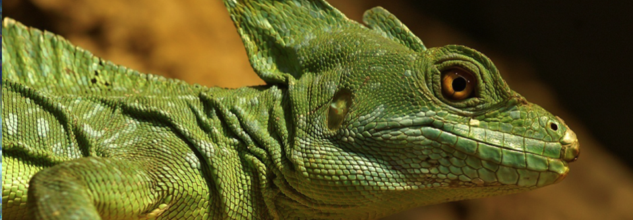
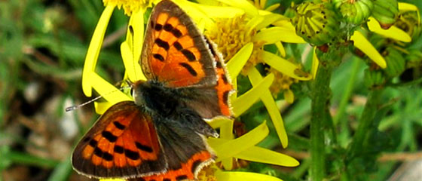
Unified reserve selection problem
new method to secure biodiversity patterns & processes
package on CRAN
applied to any system
more effective solutions

Slide 21
Environmental and geographic variables are effective surrogates for conservation planning

Slide 22
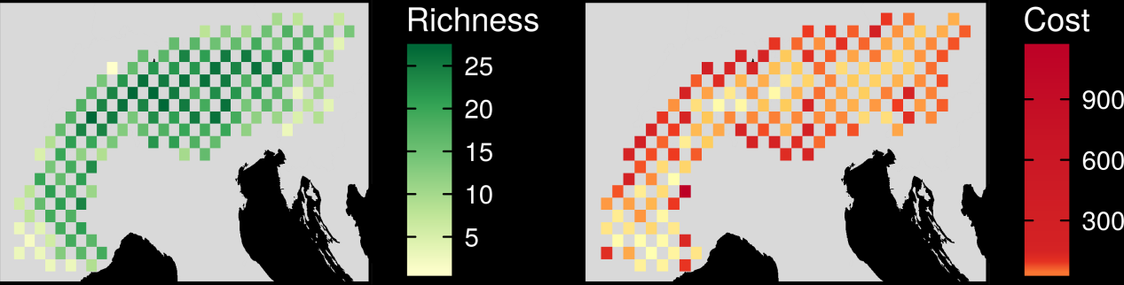
Study area

Slide 23
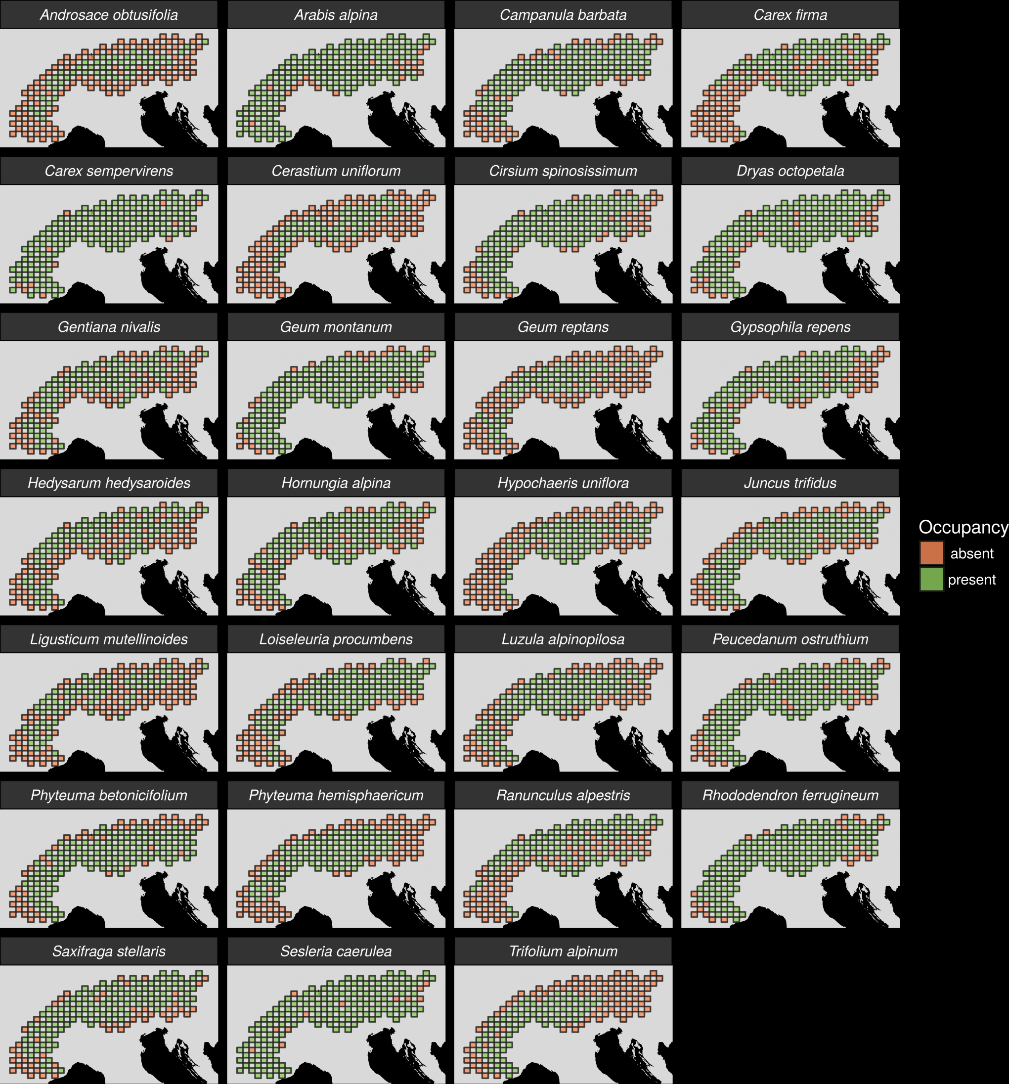

Slide 24
Methods
Identify loci under selection
BayeScan
pcadapt

Slide 25
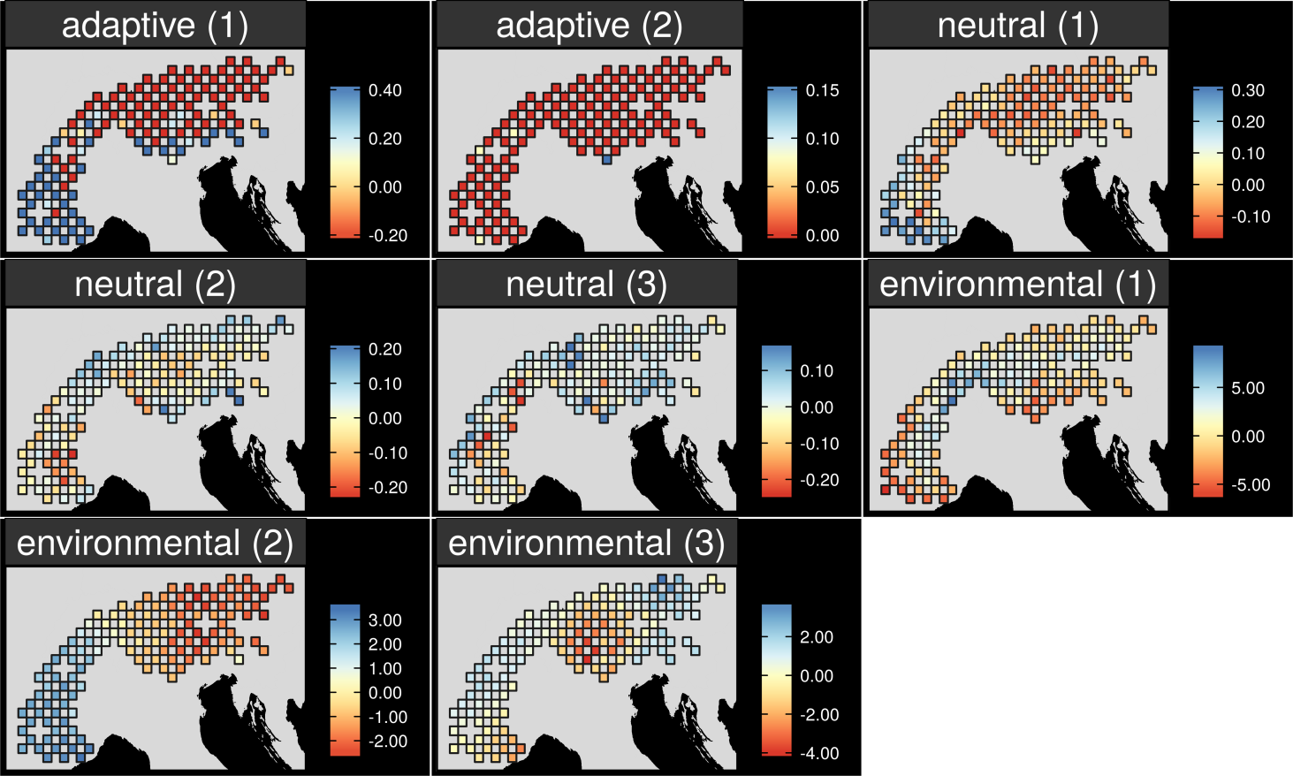
Methods
Map intra-specific variation

Slide 26
1. Do spatial patterns of surrogates correlate with genetic variation?

Slide 27
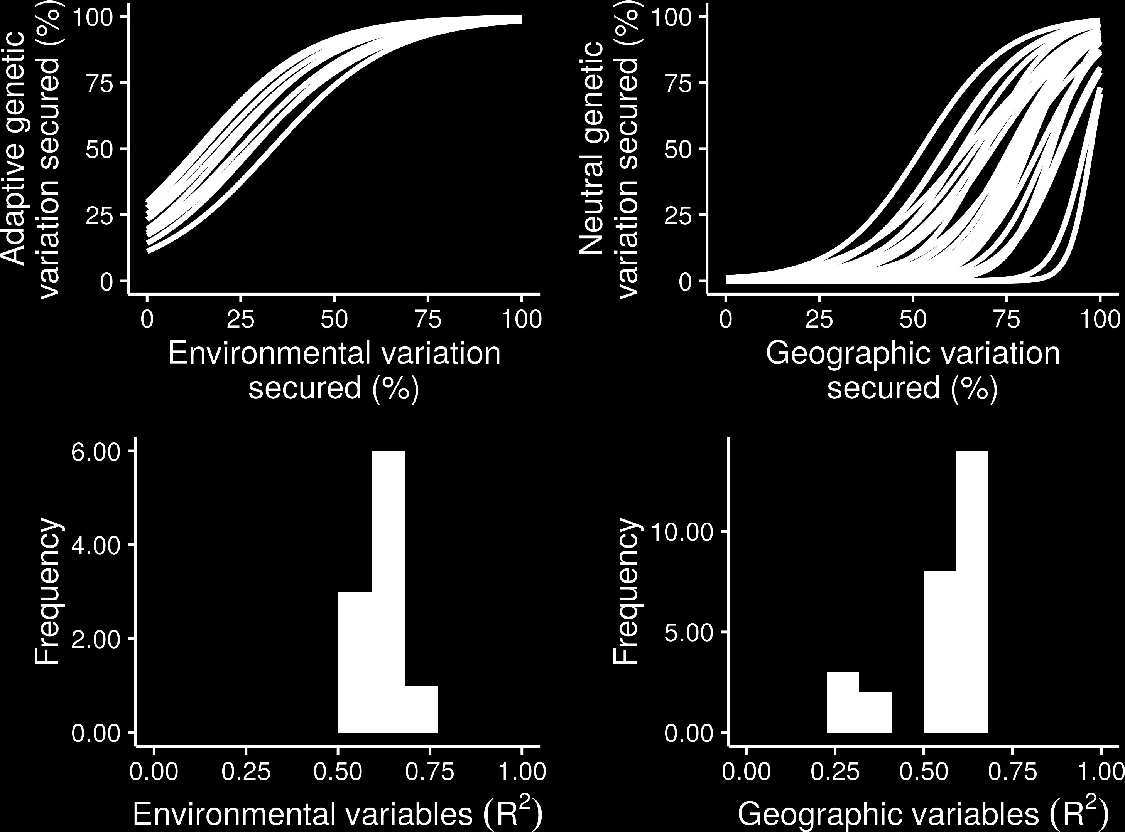
2. What is the relationship between the surrogate and genetic variation captured in random prioritizations?

Slide 28
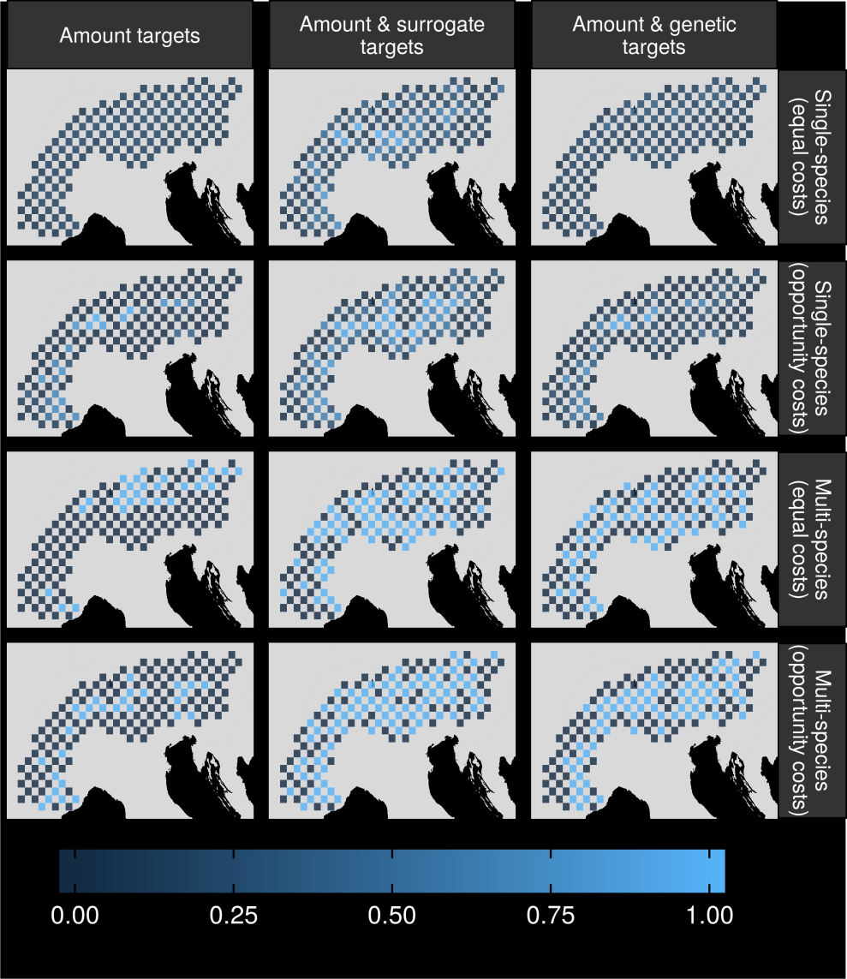
3. How well do prioritizations generated using surrogates for intra-specific genetic variation perform?

Slide 29
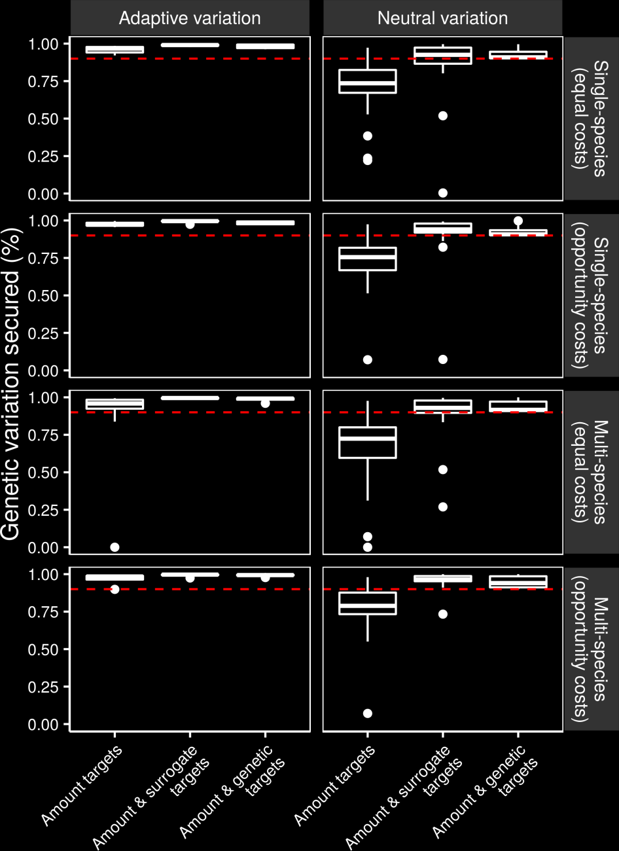

Slide 30
Surrogate performance
Effective for most species
Conventional methods may capture adaptive variation
Performance of geographic distances may depend on dispersal mechanisms

Slide 31


Is habitat suitability an effective surrogate for gene flow in conservation planning?
Preliminary results

Slide 32
Landscape resistance

Slide 33
Methods

Slide 34
Methods

Slide 35
Reserve selection
Habitat suitability
Dispersible habitat
Solution

Slide 36
Reserve selection
Habitat suitability
Surrogate
Solution

Slide 37
Solution performance
Genetic-based solution
Surrogate-based solution

Slide 38
Solution performance
Genetic-based solution
Dispersible habitat
Surrogate-based solution
Maximum 8 units of
connected habitat
Maximum 5 units of
connected habitat

Slide 39
Data
12 gravity and animal-assisted dispersing species

Slide 40
Calibration

Slide 41
Effective for some species?

Slide 42
Habitat as a surrogate for gene flow
Might work for some species
Complicated by dispersal mechanisms
Incorporate species-specific connectivity into prioritizations

Slide 43
Global conservation of realized niches
How well are species’ realized niches conserved in protected areas?
Which places offer the greatest conservation benefit?

Slide 44
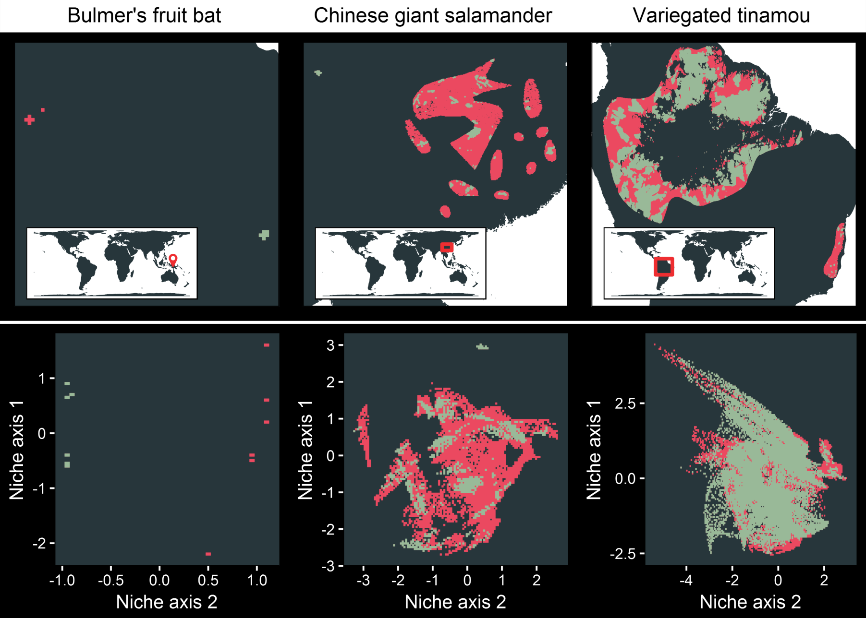
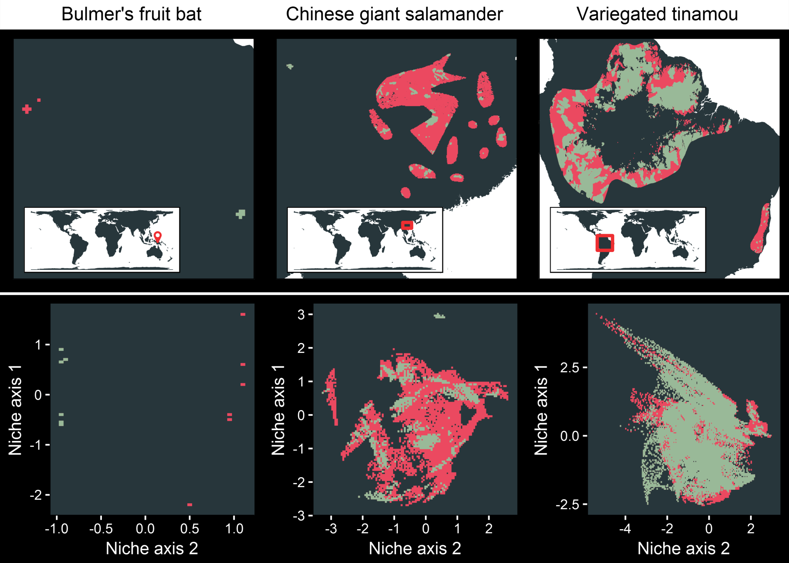
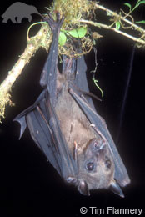
Niche representation metrics
Bulmer’s fruit bat
Geographic space
Niche space
Niche variation
sampled = 0.01 %
Niche volume
protected = 53 %

Slide 45
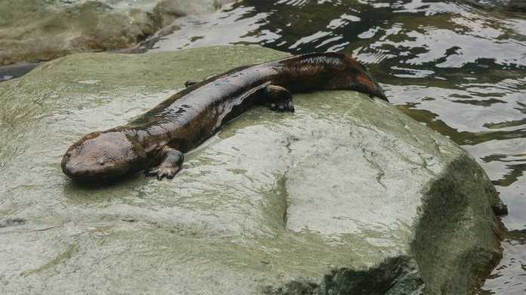
Niche representation metrics
Chinese giant salamander
Geographic space
Niche space
Niche variation
sampled = 98.22 %
Niche volume
protected = 14.01 %

Slide 46
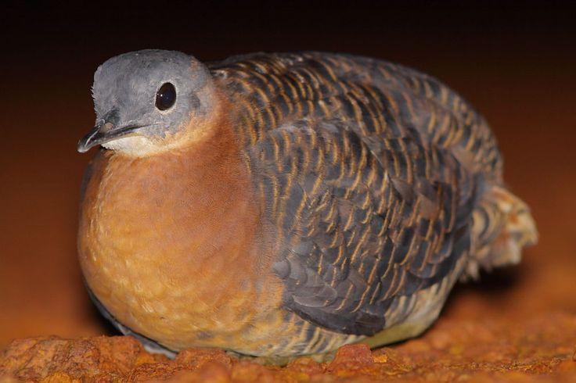
Niche representation metrics
Variegated
tinamou
Geographic space
Niche space
Niche variation
sampled = 98.22 %
Niche volume
protected = 14.01 %

Slide 47
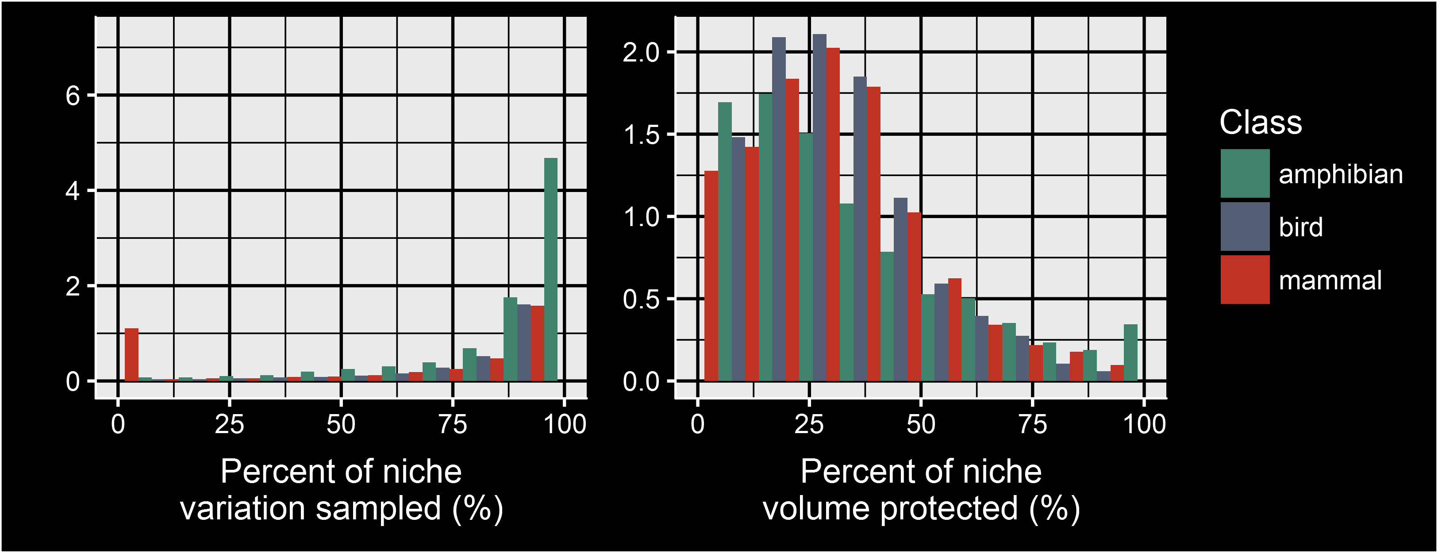
Global niche representation

Slide 48
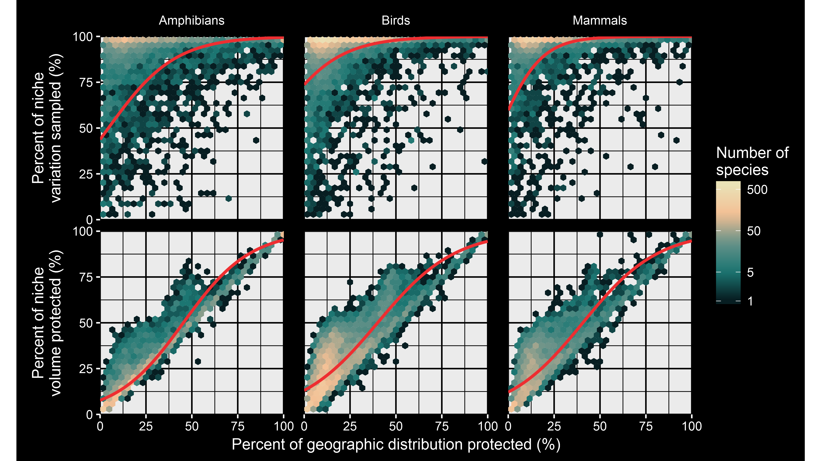

Slide 49
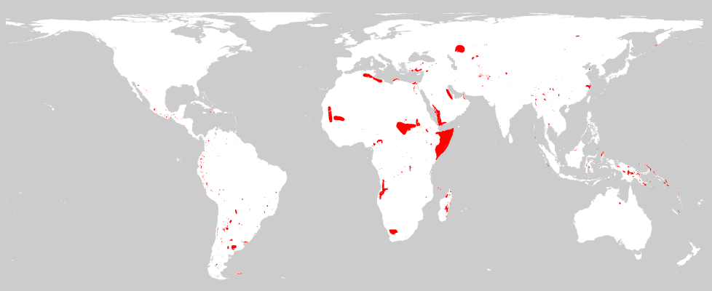
Species missing from protected areas

Slide 50
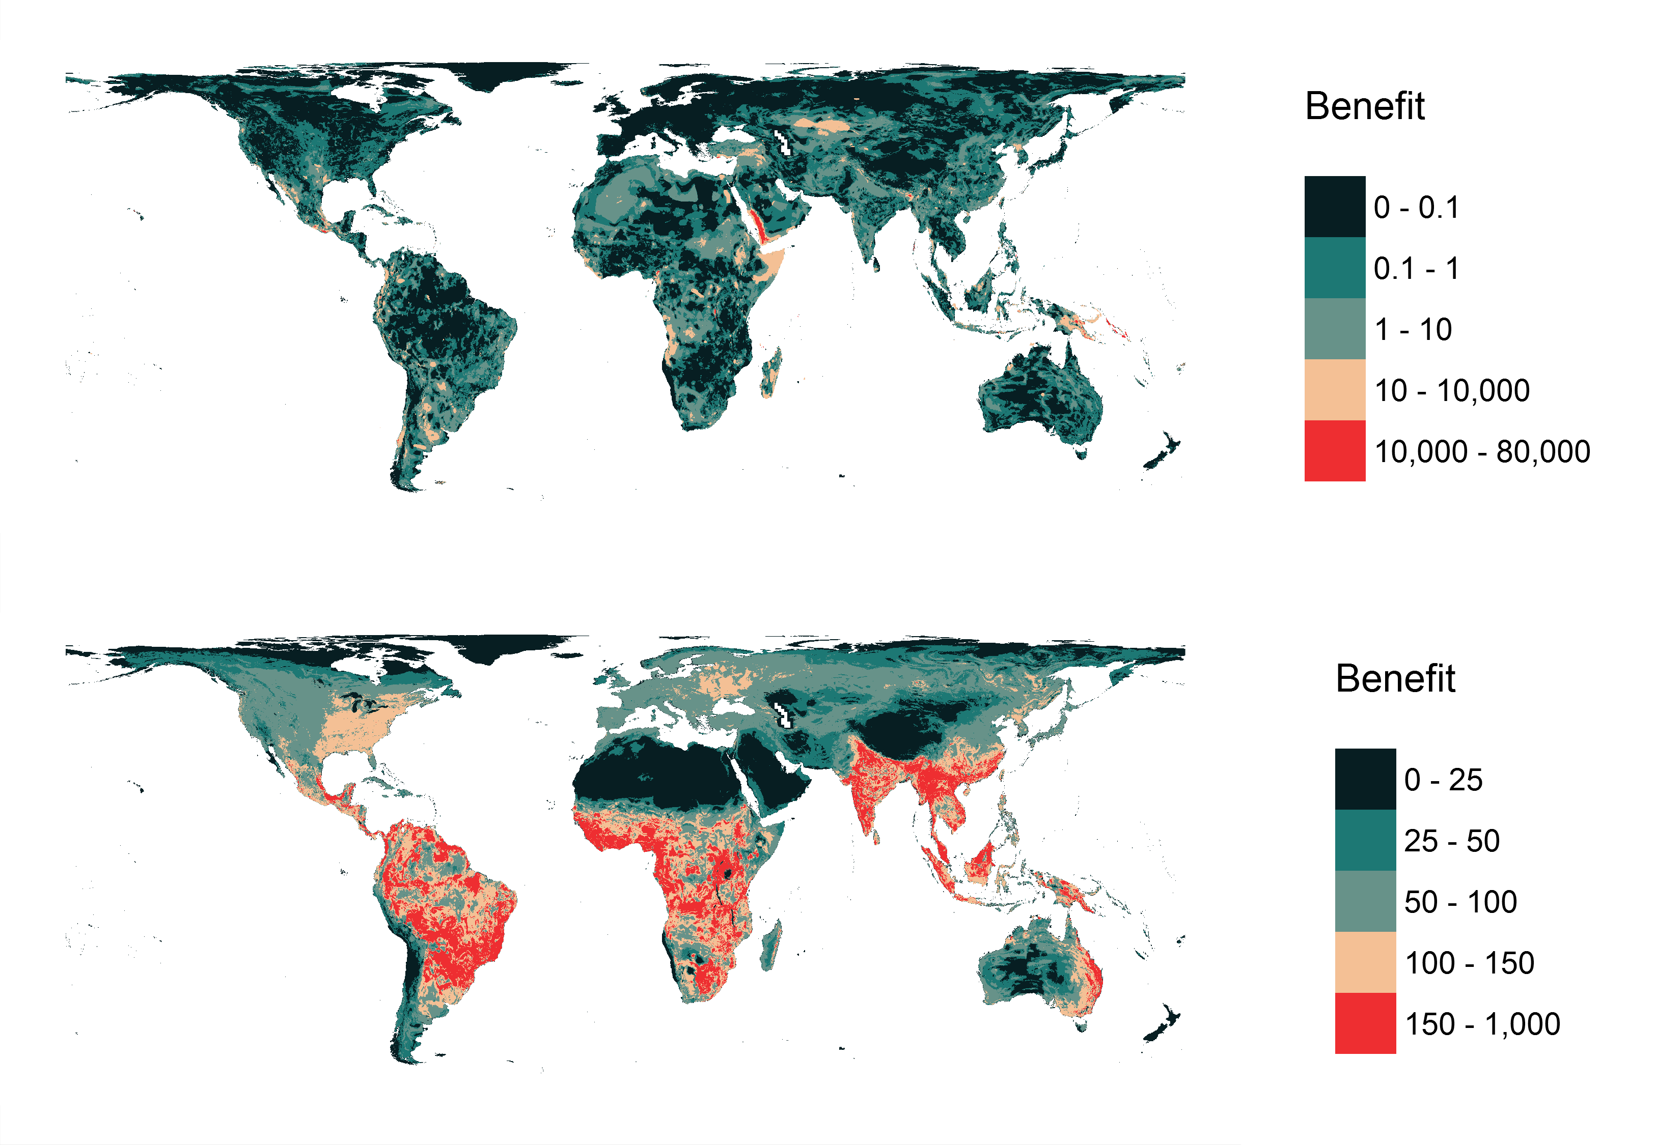
Niche variation benefit

Slide 51
Niche volume benefit

Slide 52
Global conservation of niches
Proportion of geographic range conserved is a poor predictor for how well niche variation is conserved
Protected areas tend to be scattered across niches

Slide 53
Take home messages
If you want it: you need to plan for it
Surrogates may work – but no guarantees
We need to plug the gaps in the global protected area network

Slide 54



jeffrey.hanson@uqconnect.edu.au
www.github/jeffreyhanson
jeffrey-hanson.com

